Slide 1
Model-Based Requirements Documentation

Slide 2
Model Based Requirements
The following three types of requirements are documented independently and used in conjunction:
Goals describe intentions of stakeholders or groups of stakeholders. Goals can potentially conflict with one another.
Use cases and scenarios document exemplary sequences of system usage. Scenarios are grouped together in use cases.
System requirements (generally referred to as requirements) describe detailed functions and qualities that the system to be developed shall implement or possess.

Slide 3
Property of Models
The Term Model:
A model is an abstract representation of an existing reality or a reality to be created.
Properties of Models:
Mapping of reality: Every model maps certain aspects of the observed reality onto its modeling elements. Model creation can be descriptive and prescriptive in nature.
In the case of descriptive model construction, the resulting model documents the existing reality.
In the case of prescriptive model construction, the resulting model serves as a prototype for a fictitious reality.

Slide 4
Property of Models (Contd…)
Reduction of reality: Models reduce the mapped reality. It is common to differentiate between selection and compression.
During selection, only particular aspects that are part of the universe of discourse of the system are modeled.
In contrast, aspects of the subject-matter of the system are summarized during compression.

Slide 5
Property of Models (Contd…)
Pragmatic property: A model is always constructed for a special purpose and within a special context.
The purpose of the model may affect the construction and the purpose-driven reduction of reality within the models.
Ideally, a model contains only the information necessary for the respective purpose.

Slide 6
Modelling Languages
Syntax and semantics
A modeling language is defined by its syntax and semantics:
Syntax: The syntax of a modeling language defines the modeling elements to be used and specifies the valid combinations thereof.
Semantics: The semantics defines the meaning of the individual modeling elements and serves therefore as a foundation for the interpretation of the models of the respective modeling language.

Slide 7
Modelling Languages
Different degrees of formalization
Conceptual modeling languages can be classified as formal, informal, and semiformal, depending on the degree of formalization.
The degree of formalization of a modeling language depends on the magnitude of formal definitions (e.g., mathematical calculus) that define the syntax and semantics.

Slide 8
Requirements Models
Conceptual models that document the requirements of a system are called requirements models.
The Unified Modeling Language (UML) is frequently used to construct requirements models
UML consists of a set of partially complementary modeling languages that are particularly used in requirements engineering to model the requirements of a system from different perspectives.

Slide 9
Requirements Models (Contd…)
Advantages of Requirements Models
Increased understandability
Research on human cognition has shown that information can be perceived and memorized faster and better when depicted graphically as opposed to making use of natural language.
These findings can be applied to the use of requirements models in particular.

Slide 10
Requirements Models (Contd…)
Support perspectives of documentation
An additional advantage when using requirements models is that in contrast to natural language, the modeling languages used have a strictly defined focus.
Requirements models also have the advantage that the different types of modeling elements within the same modeling language dictate the method of abstraction as well as what is being abstracted and what is not.

Slide 11
Requirements Models (Contd…)
Combined Use of Models and Natural Language
Using both natural language and requirements models in combination allows the advantages of both documentation techniques to be exploited while minimizing their disadvantages.
For example, natural language requirements can be summarized and their interrelations depicted using models.
On the other hand, natural language can help enrich requirements models and modeling elements with additional information.

Slide 12
Goal Models
Many methods in requirements engineering are based on the explicit consideration of stakeholders’ intentions by means of goals
Goals are a stakeholder’s (e.g., a person’s or an organization’s) description of a characteristic property of the system to be developed or the development project.

Slide 13
Goal Models (Contd…)
Natural-language-based and model-based documentation
Goals are very well suited to refine the vision of the system.
Refining a goal is known as goal decomposition.
Goals can be documented using natural language (e.g., by means of predesigned templates) or using goal models.
A widely known and very common goal modeling technique is the use of AND/OR trees. By means of AND/OR trees, hierarchical decompositions can be documented.
The type of refinement relation is depicted by graphic representations of the branches.
The direction of the goal decomposition is not represented through branches but through the top-down structure of the tree.

Slide 14
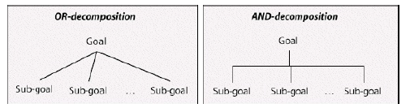
Goal Models (Contd…)
Goal Documentation Using AND/OR Trees
The following figure schematically shows two types of decomposition as well as their modelling elements:

Slide 15
Goal Models (Contd…)
AND-decomposition vs. OR-decomposition
In case of AND-decomposition, every sub-goal must be fulfilled so that the super-goal (the root) is fulfilled. In contrast, in OR decomposition, it suffices if at least one sub-goal is fulfilled so that the super-goal is met.

Slide 16
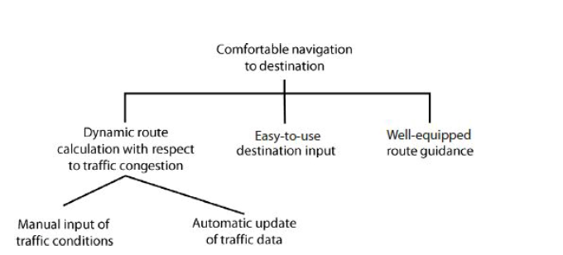
Goal Models (Contd…)
Example of AND/OR Trees
Figure shows an AND/OR tree that documents the hierarchical decomposition of the goal “Comfortable navigation to destination”.

Slide 17
Goal Models (Contd…)
Modeling goals with AND/OR trees
AND trees
The goal “comfortable navigation to destination” is refined into the following three sub-goals via AND-decomposition
“dynamic route calculation with respect to traffic congestion”,
“comfortable destination input”, and
“comfortable route guidance”.
This depicts that all three sub-goals must be met to consider the super-goal fulfilled.

Slide 18
Goal Models (Contd…)
OR trees
The sub-goal “dynamic route calculation with respect to traffic congestion” in turn is refined by the two sub-goals
“manual input of traffic conditions” and
“automatic update of traffic data”.
The type of decomposition relation depicts that only one of the two sub-goals must be met to consider the super-goal met.

Slide 19
Use Cases
Use cases were first proposed in [Jacobson et al. 1992] as a method to document the functionalities of a planned or existing system on the basis of simple models.
The use case approach is based on two concepts that are used in conjunction with one another:
Use case diagrams
Use case specifications

Slide 20
Use Cases (Contd…)
UML Use Case Diagrams
Relations between use cases
Use case diagrams in the UML are simple models to schematically document the functions of a system from a user’s perspective and to document the interrelations of the functions of a system and the relations between these functions and their environment.

Slide 21
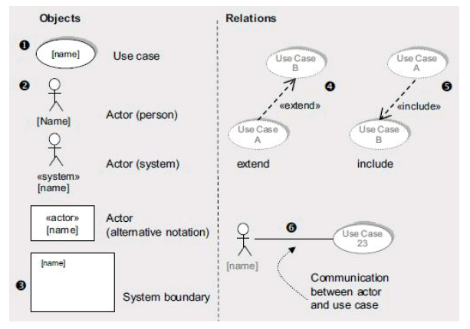
Modeling Elements of UML Use Case Diagrams

Slide 22
Modeling Elements of UML Use Case Diagrams (Contd…)
Use cases:
Uses cases that are defined for the system are depicted using oval shapes. These shapes contain the name of the use case. Alternatively, the name can be written beneath the use case.

Slide 23
Modeling Elements of UML Use Case Diagrams (Contd…)
Actors:
Actors are outside the system boundary and represent people or systems that interact with the system modeled.
Actors are depicted by a rectangle that receives the name of the actor and is tagged with the stereotype “actor”.
If the actor is a person, a stick figure may be used.
If the actor is a system, either a rectangle or a stick figure may be used in conjunction with the stereotype “system”.

Slide 24
Modeling Elements of UML Use Case Diagrams (Contd…)
System boundaries:
System boundaries within a use case diagram separate the parts of the use case that are part of the system from the parts (people or systems) that are outside the system boundary. Optionally, the name of the system may be denoted at the system boundary in the diagram.

Slide 25
Modeling Elements of UML Use Case Diagrams (Contd…)
Extend relation:
An extend relation depicts that an interaction sequence that belongs to use case A extends some interaction sequence in use case B at a specified point. This is known as the extension point. The extension is triggered by the condition defined.

Slide 26
Modeling Elements of UML Use Case Diagrams (Contd…)
Include relation:
An include relation from one use case to another use case depicts that the interaction sequence of the first use case includes the interaction sequence of the other use case.

Slide 27
Modeling Elements of UML Use Case Diagrams (Contd…)
Relation between actors and use cases:
If communication between a use case and one or more actors takes place during the execution of the use case, the communication must be annotated by means of a communication relation between the respective actors and the use case.

Slide 28
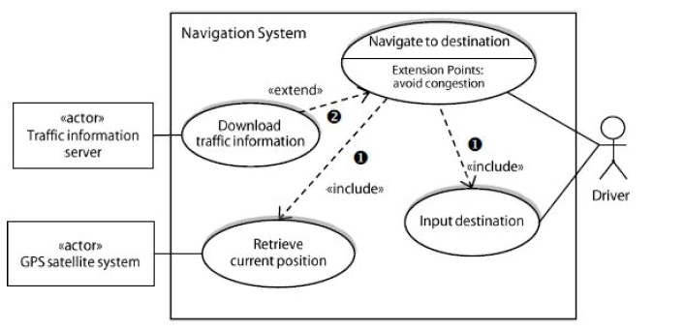
Example of UML Use Case Diagrams

Slide 29
Example of UML Use Case Diagrams (Contd..)
The model comprises the use cases “download traffic information”, “retrieve current position”, and “input navigate to destination” elements
Include
The use case “navigate to destination” is related to the use cases “input destination” and “retrieve current position” via an include relation.
The relationship depicts that the interaction steps defined in the use cases “input destination” and “retrieve current position” are contained in the use case “navigate to destination”.

Slide 30
Example of UML Use Case Diagrams (Contd..)
Extend
The extend relation between the use cases “download traffic information” and “navigate to destination” defines that the interaction steps defined in the use case “download traffic information” are included in the interaction steps of the use case “navigate to destination” if a certain condition, such as “avoid congestion”, is met.
The extension point “avoid congestion” depicts the step in the use case “navigate to destination” at which the additional interaction steps are being executed.

Slide 31
Generalization
UML also provides a generalization relation between use cases or actors.
In this case, the specializing use cases or actors inherit the properties of the generalizing use case or actor.
For instance, the actors “service mechanic” and “customer service representative” can be generalized as the actor “employee”.
The generalizing actor would carry all aspects that the actors “service mechanic” and “customer service representative” have in common (e.g., employee ID).

Slide 32
Use Case Specifications
Use case diagrams show the system’s relevant functions from a user’s perspective and specific relationships between the functions of the system or between functions of the system and aspects in the system’s context.
With the exception of a use case’s name and its relationships, use cases diagrams do not document any information about the individual use cases such as the systematic interaction between a use case and an actor.
This information is documented textually by means of adequate templates in conjunction with use case diagrams.

Slide 33
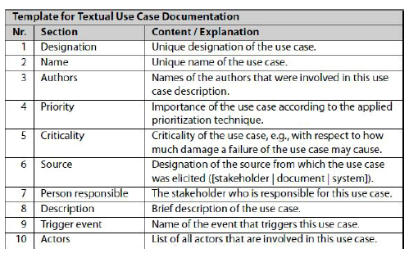
Use Case Specification (Contd..)

Slide 34
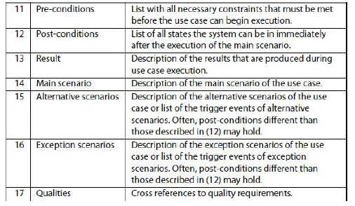
Use Case Specification (Contd..)

Slide 35
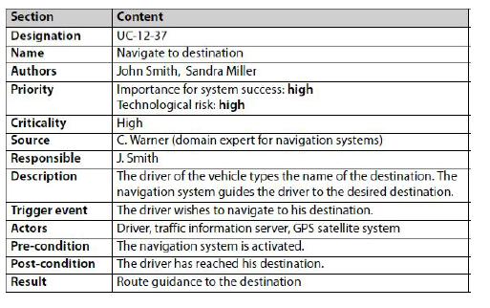
Use Case Specification Example

Slide 36
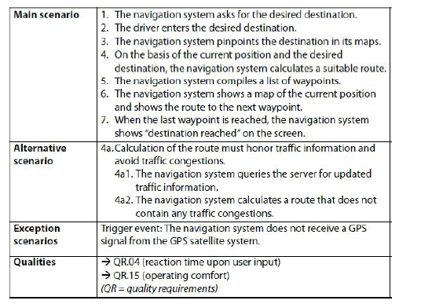
Use Case Specification Example

Slide 37
Three Perspectives on the Requirements
Separately documenting the perspectives
Data perspective: In this perspective, the structures of input and output data as well as static-structural aspects of the usage and dependency relationships of the system in the system context are documented.
Functional perspective: This perspective documents which information of the system context is being manipulated by the system to be developed and which data is being transmitted to the system context by the system.

Slide 38
Three Perspectives on the Requirements
Behavioral perspective: The embedding of the system in the system context is documented on the basis of states in this perspective.
This is done, for instance, by documenting the reaction of the system to events within the system context. documenting the conditions that trigger a state change, or documenting the effects that the system has on its environment.

Slide 39
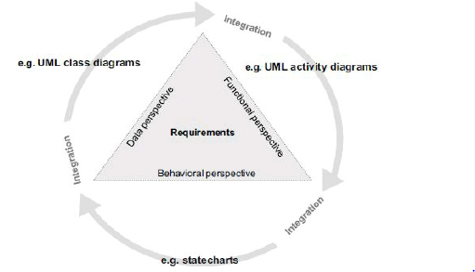
Perspectives are not disjoint.

Slide 40
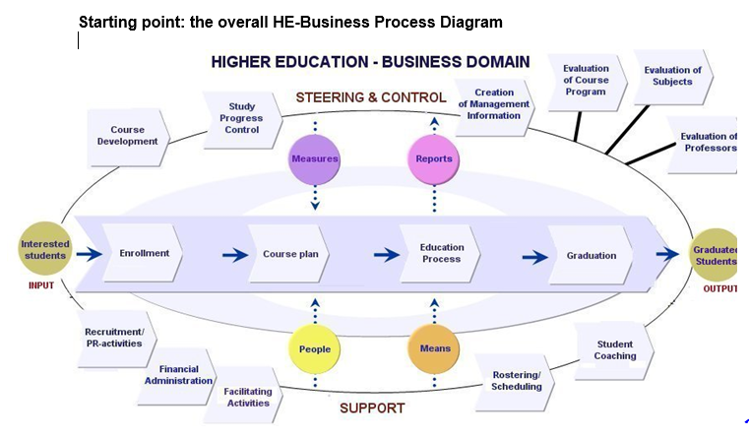
BUSINESS DOMAIN DIAGRAM

Slide 41
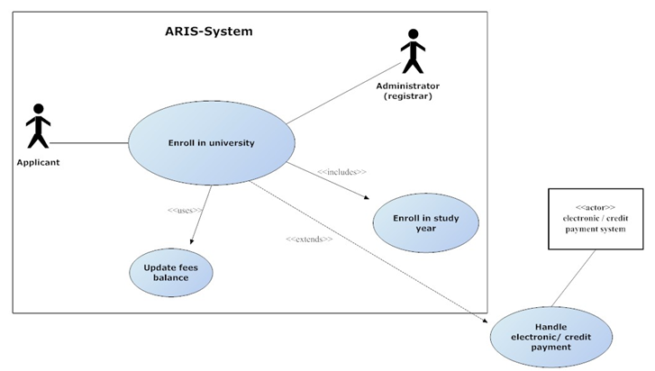
Use Cases Example

Slide 42
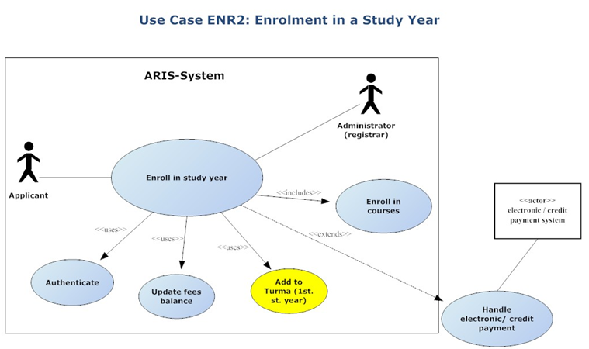
Use Cases Example

Slide 43
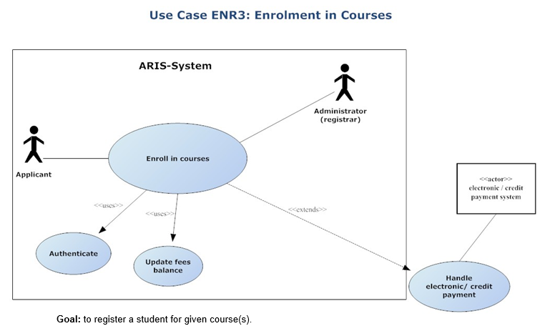
Use Cases Example

Slide 44
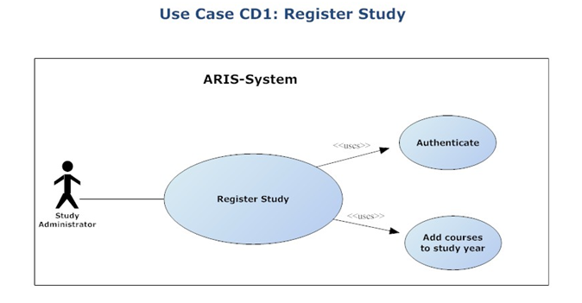
Use Cases Example

Slide 45
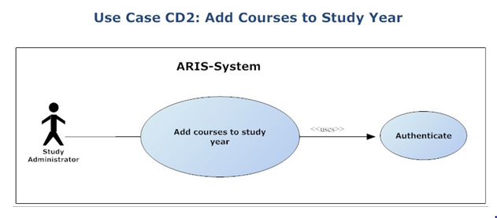
Use Cases Example

Slide 46
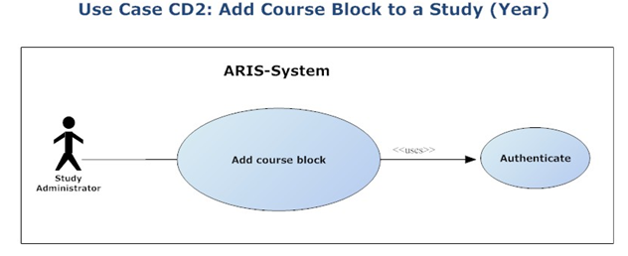
Use Cases Example

Slide 47
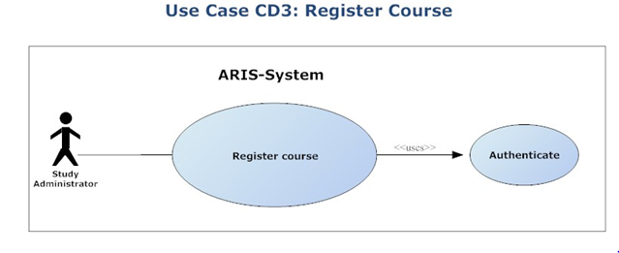
Use Cases Example

Slide 48
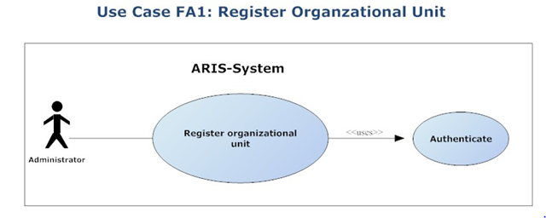
Use Cases Example

